Slide 1
LINK
GROUP
LINK
Automation Engineering (Shanghai) Co.,Ltd.
GROUP
霖和自动化工程(上海)有限公司
Training Record
Pham Tung Lam : PLC Engineer
Module SAS

Slide 2
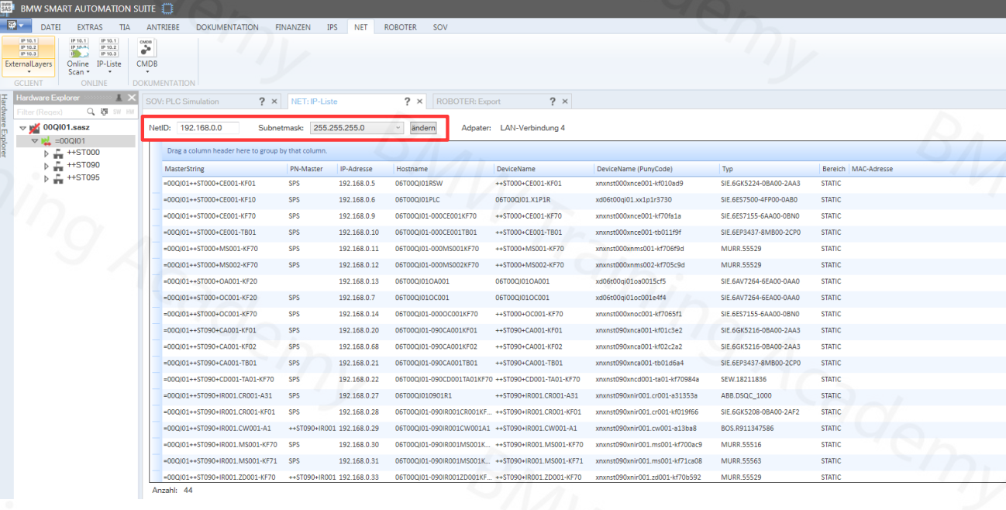
SAS PLUGINS - IP-NET-LIST
The IP addresses of the individual modules are set using the IP list plugin.

Slide 3
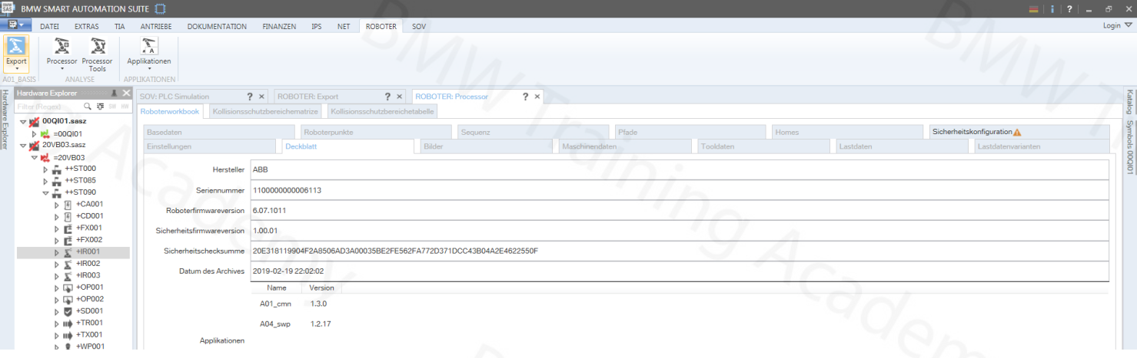
SAS PLUGINS— ROBOT PROCESSOR
The robot processor plugin is used to document and check the robot programs.

Slide 4
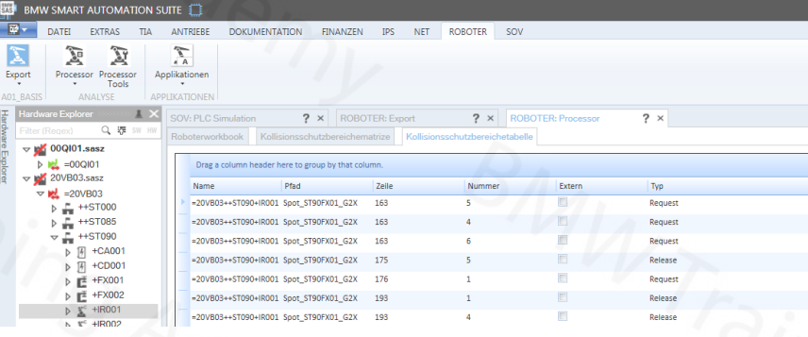
Collision Protection Area Table

Slide 5
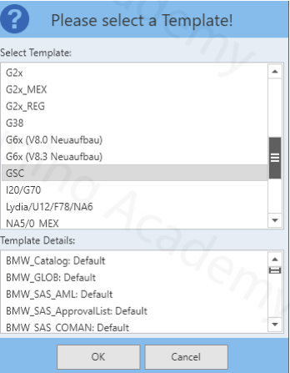
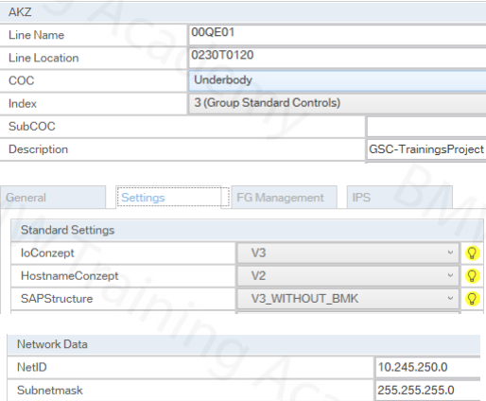
GETTING STARTED - CREATE NEW SAS FILE

Slide 6
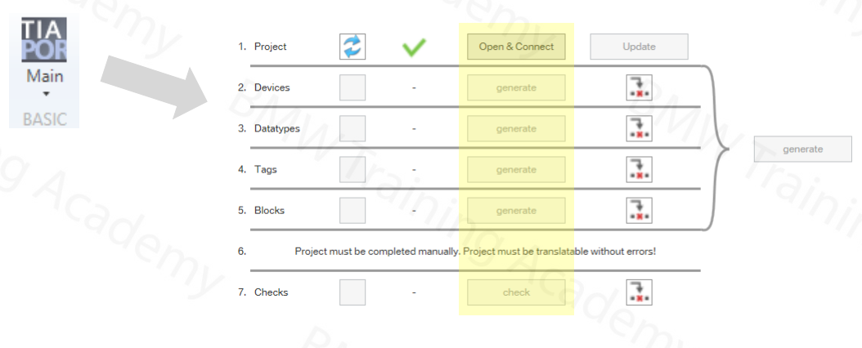
TIA EXPORT
The export to the system project can be carried out with the "Main" function under the"TIA" menu item for a new project to be created.

Slide 7
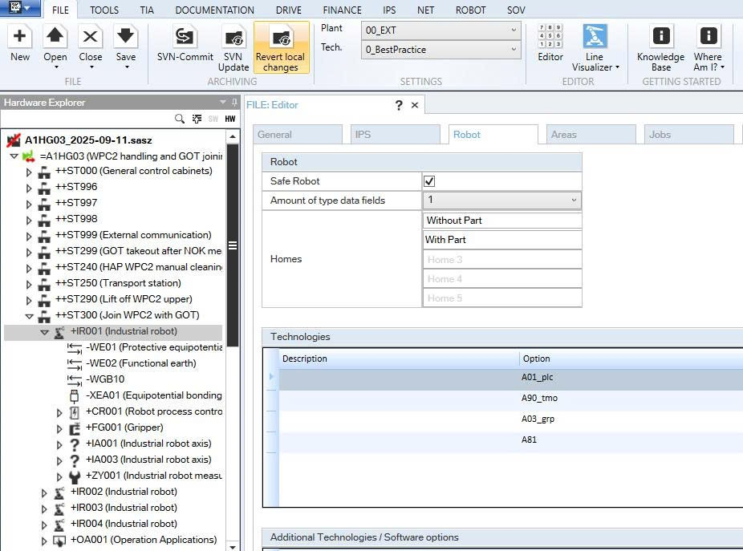
Configure option

Slide 8
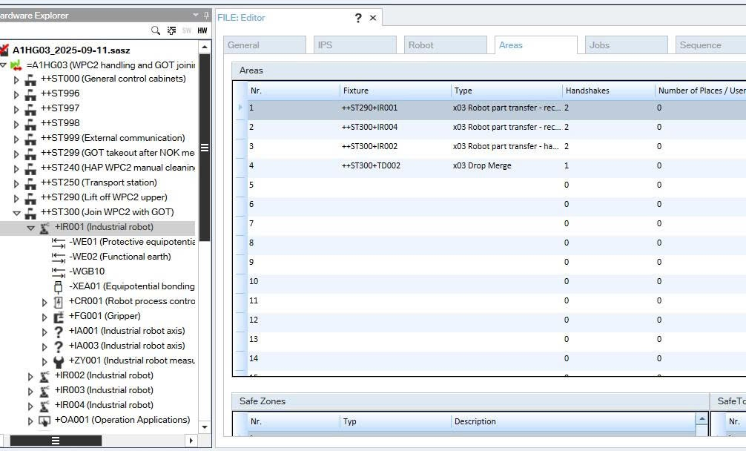
Working with robot in SAS
Configure area and type

Slide 9
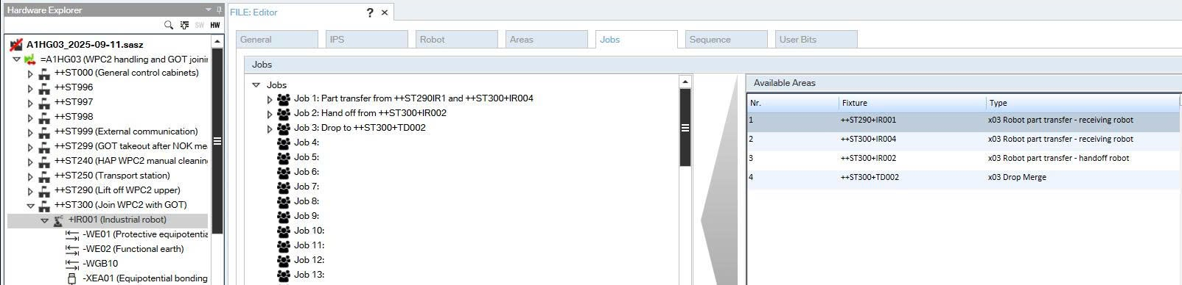
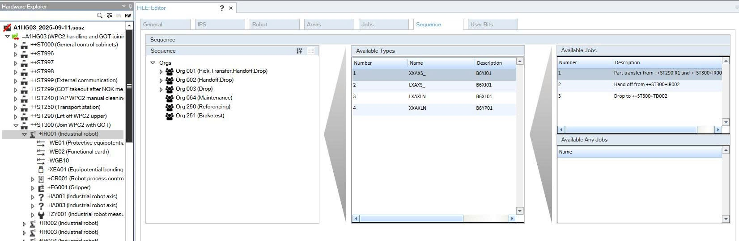
Configure job and Program

Slide 10
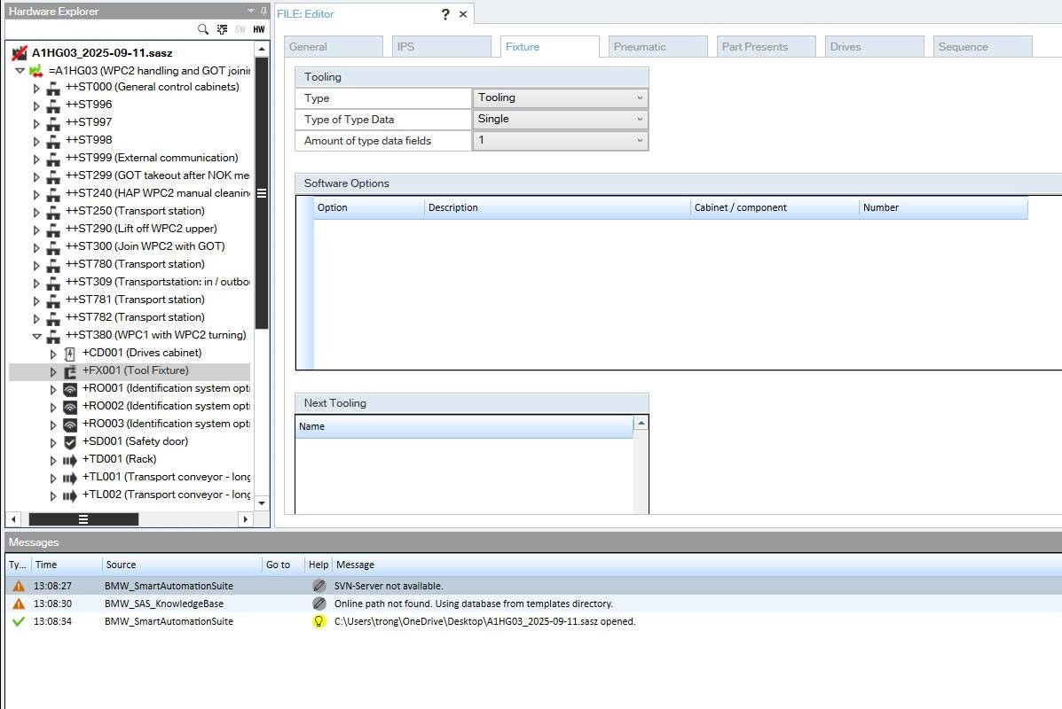
Working with Fixture in SAS

Slide 11
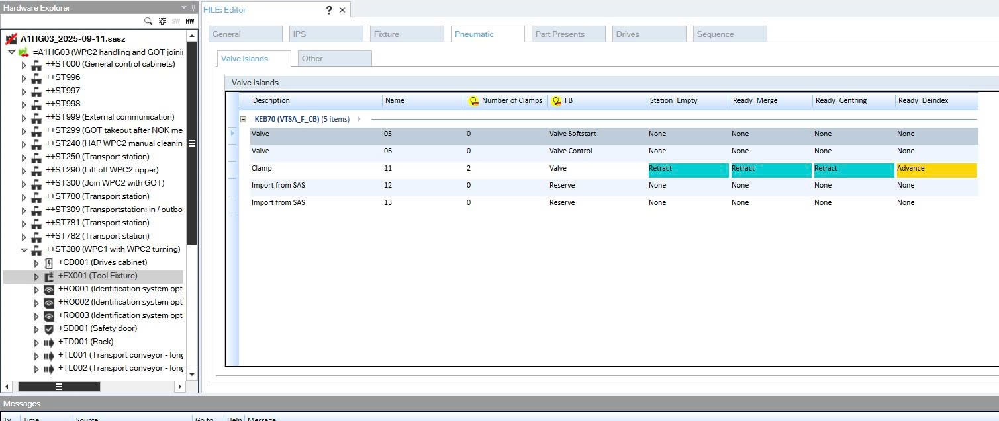

Slide 12
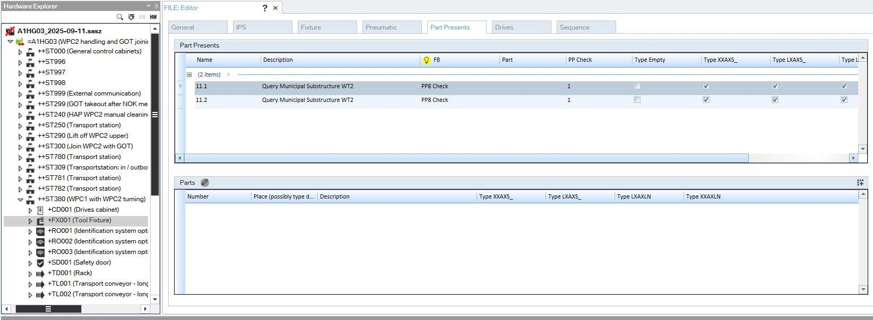
Configure Sensor type base on application, PP1 PP8, PPHMI ….
Configure which sensor use for which type

Slide 13
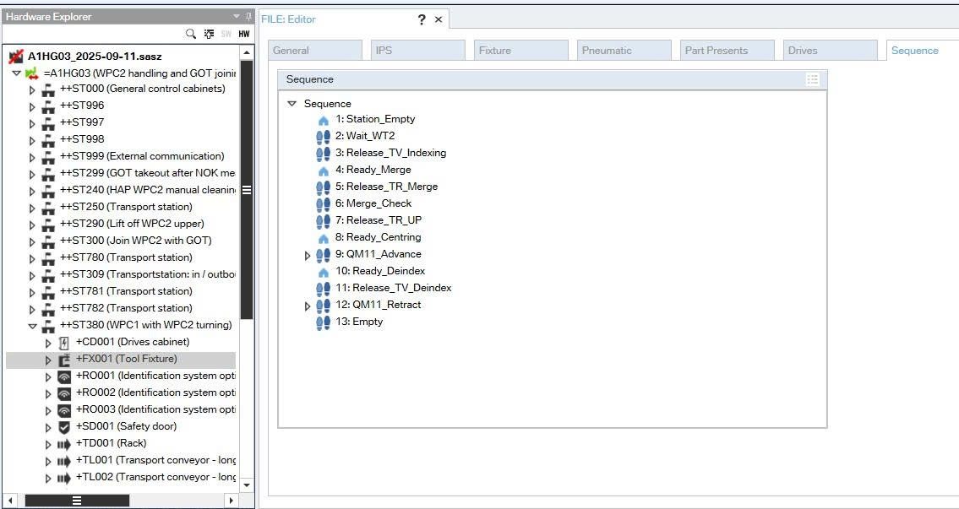
Basic Graph and Phases are written here be for export to TIA

Slide 15



Contact Us
LINK Group Headquarter
Shanghai, China
LINK Group North China
Shenyang, China
LINK Group Europe (LKGG GmbH)
Bad Reichenhall, Germany
Enquiry
Enquiry
Enquiry
ying.liu@LKautomation.com
kimi.wang@LKautomation.com
jackey.yin@LKautomation.com
+86 021 6918 0161
+86 021 6918 0161
+86 186 2171 9367
Sales
Sales
Sales
gene.zhang@LKautomation.com
gene.zhang@LKautomation.com
andreas.reymendt@LKautomation.com
+86 136 2179 1621
+86 136 2179 1621
Address
BLDG #D,North Jiasong Road No.3570 Jiading District,Shanghai,P.R.China
Address
NO. 14 22nd Floor,NO.168-3 Harbin Road,
Shenhe District,Shenyang,Liaoning
Province,P.R.China
Address
Fischerbraeuwiese 18b,83435 Bad
Reichenhall,Bavaria,Germany

